Slide 1



Slide 2


Thank You
Project Resource is a program of the College for Bishops whose mission and purpose is to support bishops, and therefore, their dioceses, through personal and professional development, strengthening and empowering their vocation of carrying out God’s mission in the world.

Slide 3

Thank You to Our Sponsors!
Vandersall Collective
VandersallCollective.com

Slide 4

facebook.com/groups/projectresource

Slide 5
Week 5 – Meditation, Matthew 22:15-22
The Pharisees went and plotted to entrap Jesus in what he said. So they sent their disciples to him, along with the Herodians, saying, “Teacher, we know that you are sincere, and teach the way of God in accordance with truth, and show deference to no one; for you do not regard people with partiality. Tell us, then, what you think. Is it lawful to pay taxes to the emperor, or not?” But Jesus, aware of their malice, said, “Why are you putting me to the test, you hypocrites? Show me the coin used for the tax.” And they brought him a denarius.

Slide 6
Week 5 – Meditation, Matthew 22:15-22
Then he said to them, “Whose head is this, and whose title?” They answered, “The emperor’s.” Then he said to them, “Give therefore to the emperor the things that are the emperor’s, and to God the things that are God’s.” When they heard this, they were amazed; and they left him and went away.

Slide 7
Week 5 - Project Resource Review
Week 1:
3-Legged Stool of Fundraising:
Annual Pledge Campaigns
Major Gifts
Planned Giving
Virtual Binder | Week 5 | Page 1

Slide 8
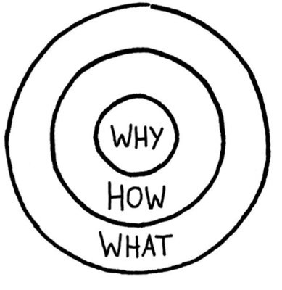
Week 5 - Project Resource Review
Week 1:
Stewardship as a Contextual Ministry
What is the ‘Why’?
Virtual Binder | Week 5 | Page 1

Slide 9
Week 5 - Project Resource Review
Week 2:
Donor Characteristics = Pastoral Ministry
Virtual Binder | Week 5 | Page 1

Slide 10
Week 5 - Project Resource Review
Weeks 3 & 4:
Annual Giving
Virtual Binder | Week 5 | Page 1

Slide 11
Week 5 - Project Resource Review
Week 5:
Major Donor Giving
Virtual Binder | Week 5 | Page 1

Slide 12












The 5 W’s of Major Giving
What?
Who?
When?
Where?
Why?
Virtual Binder | Week 5 | Page 1

Slide 13

The 5 W’s of Major Giving
When Do Donors Give Major Gifts?
Annual Stewardship (and end-of-year gifts)
Life Event (birth or death, marriage, etc.)
Capital Campaign
Planned Gift
Direct Ask for a Special Project
Virtual Binder | Week 5 | Page 1

Slide 14

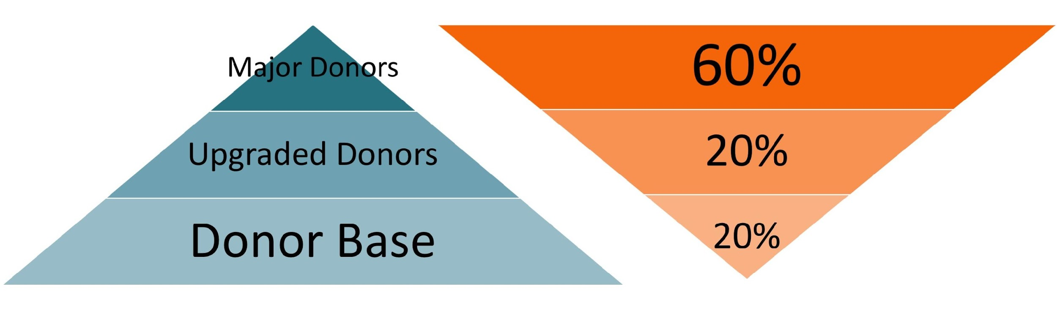
The 5 W’s of Major Giving
What is a Major Gift (for you)?
Hint: It’s all relative!
Donor Pyramid
Dollar (Reverse) Pyramid
Virtual Binder | Week 5 | Page 2

Slide 15

The 5 W’s of Major Giving
Who gives Major Gifts? (Good…)
Linkage – Is the donor connected to the congregation or faith community?
Ability – Does the donor have the financial capacity to make a large gift?
Interest – Is the donor interested in the project or program that needs funding?
Virtual Binder | Week 5 | Page 3

Slide 16
The 5 W’s of Major Giving
Who gives Major Gifts? (Better!)
Linkage – How deeply is the donor connected to the congregation or faith community?
Involvement – Is the donor involved in planning and strategy?
Advocacy – Has the donor been an active voice for the congregation or faith community?
Virtual Binder | Week 5 | Page 3

Slide 17
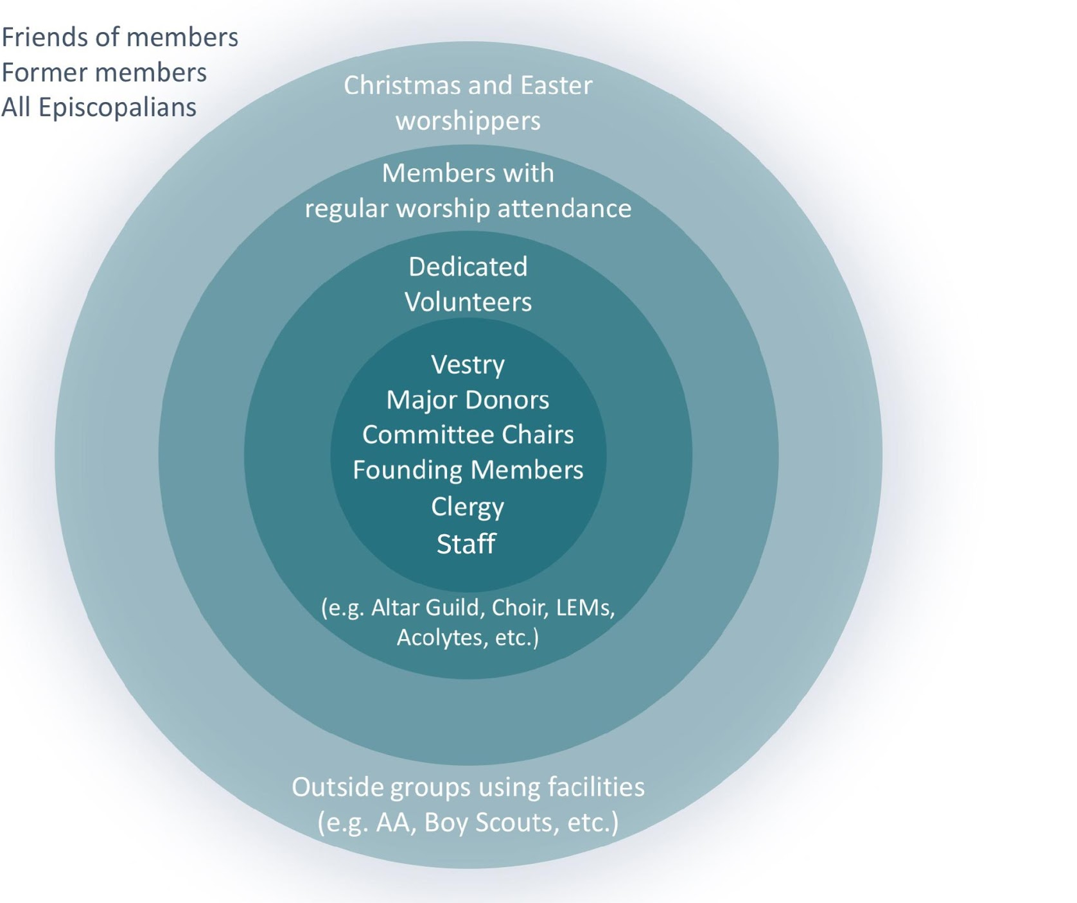
The Constituency Model
Virtual Binder | Week 5 | Page 4

Slide 18
The 5 W’s of Major Giving
The Constituency Model Post-COVID
Post-COVID Considerations
Your online constituency should be considered here.
Who has made comments?
Who has followed up or been very consistent?
Who has begun to give?
Who is a surprise?
Virtual Binder | Week 5 | Page 4

Slide 19

The 5 W’s of Major Giving
Where Do Donors Give Major Gifts?
Organizations that matter most to them!
Virtual Binder | Week 5 | Page 4

Slide 20
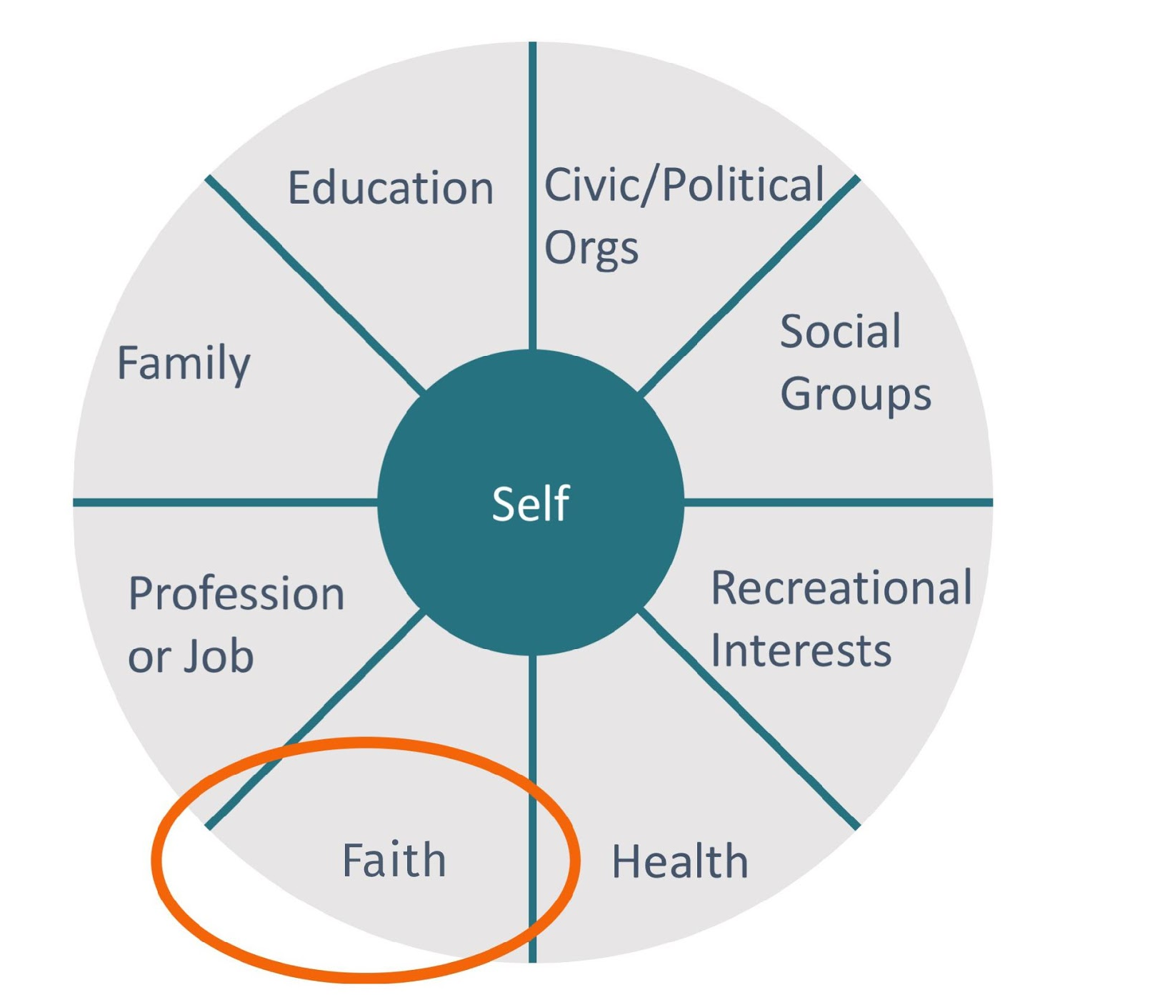
The 5 W’s of Major Giving
The Wheel of Roles
& Responsibilities
Virtual Binder | Week 5 | Page 5

Slide 21
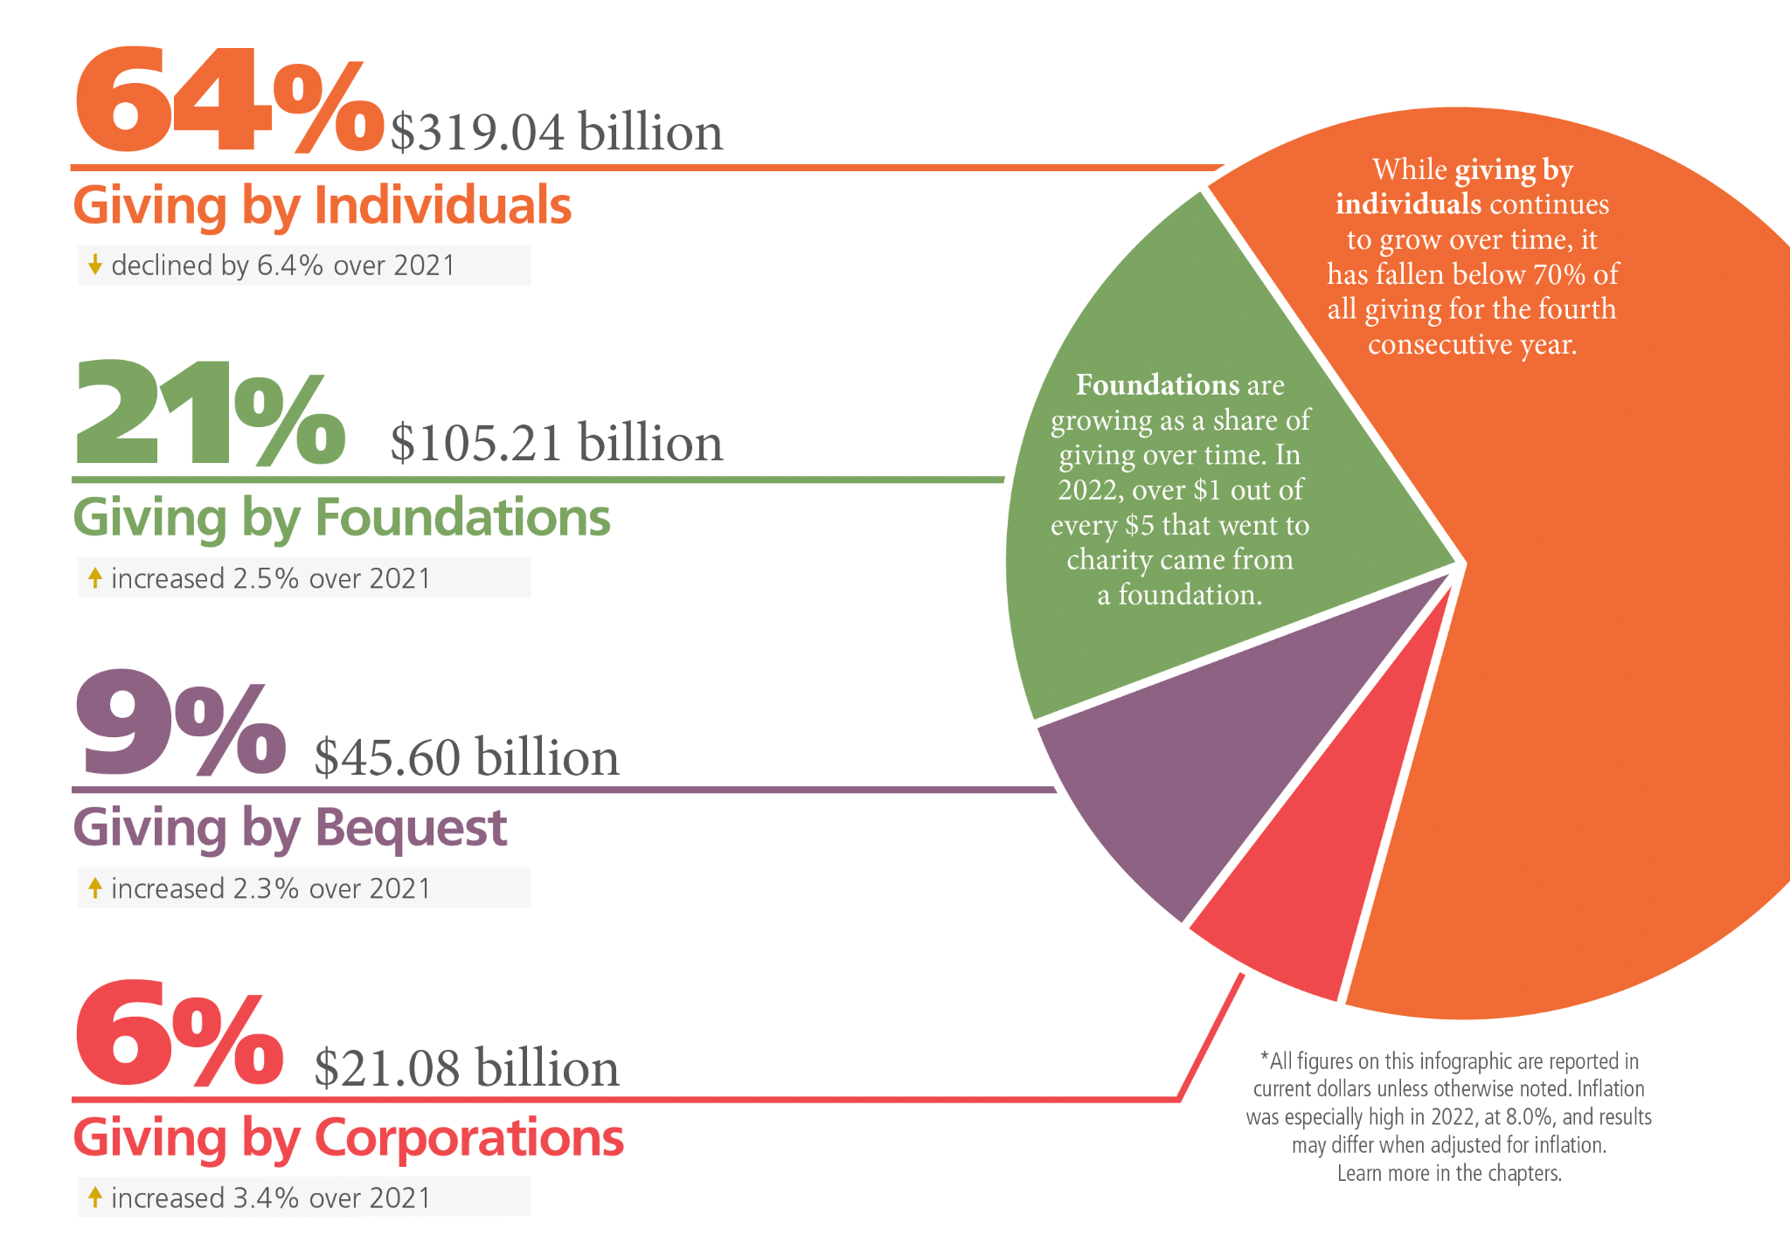
The 5 W’s of Major Giving
Virtual Binder | Week 5 | Page 5

Slide 22
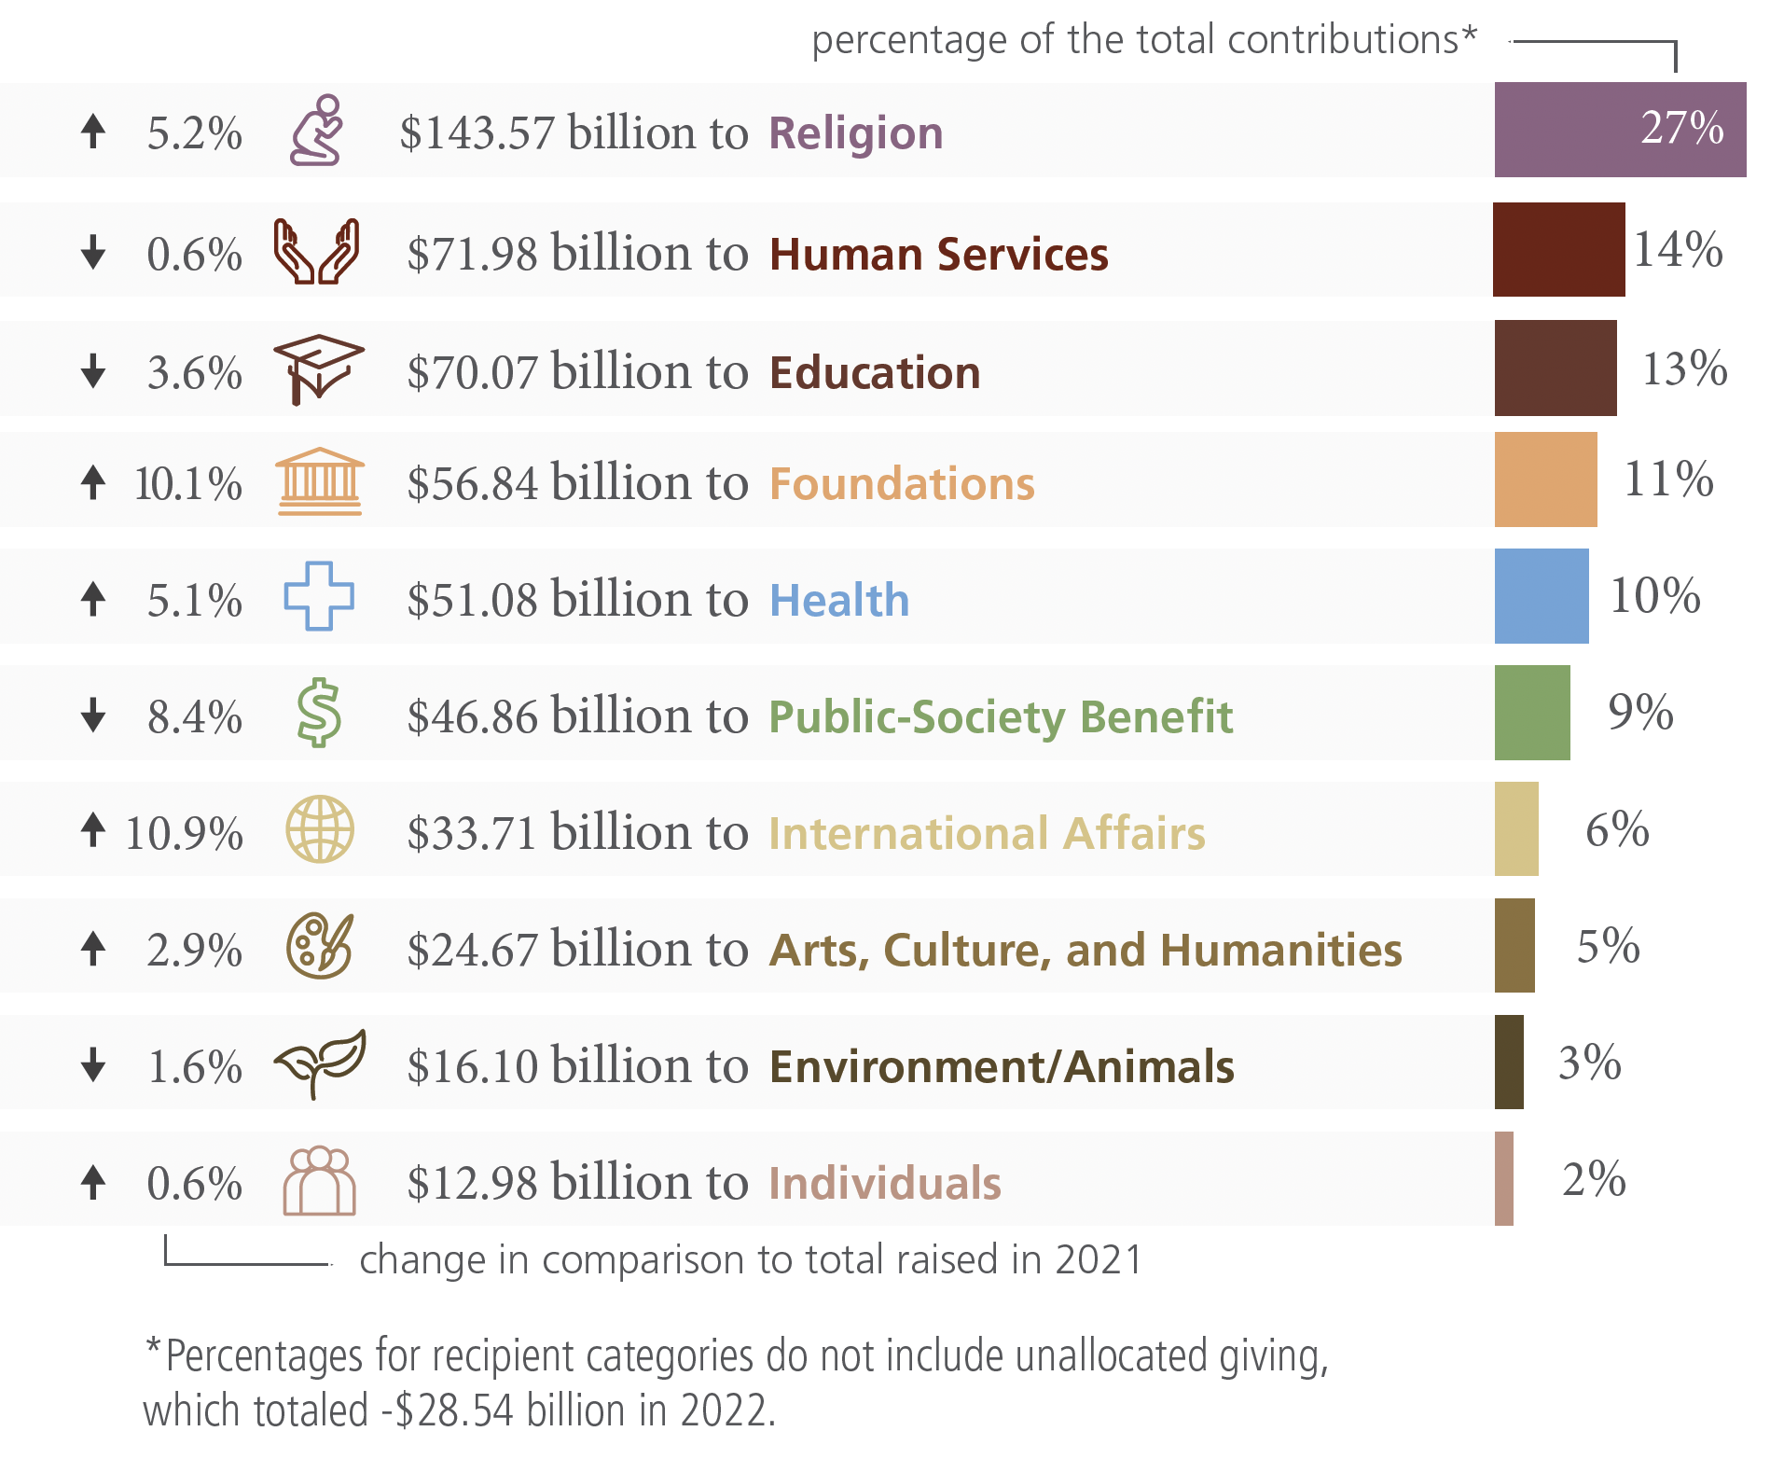
The 5 W’s of Major Giving
Virtual Binder | Week 5 | Page 5

Slide 23
The 5 W’s of Major Giving
Research
Giving USA: Where donors give gifts
https://givingusa.org/giving-usa-limited-data-tableau-visualization/
Episcopal Church Community Profile: demographics & giving trends
https://www.episcopalchurch.org/research-and-statistics/
Collective Foundation
https://collectivefdtn.org/report
Virtual Binder | Week 5 | Page 5

Slide 24

The 5 W’s of Major Giving
Why Do Donors Give Major Gifts?
Top Three Reasons:
Being asked by someone you know well.
Because you volunteered at the organization.
Being asked by clergy to give.
Source: Independent Sector
Virtual Binder | Week 5 | Page 6

Slide 25
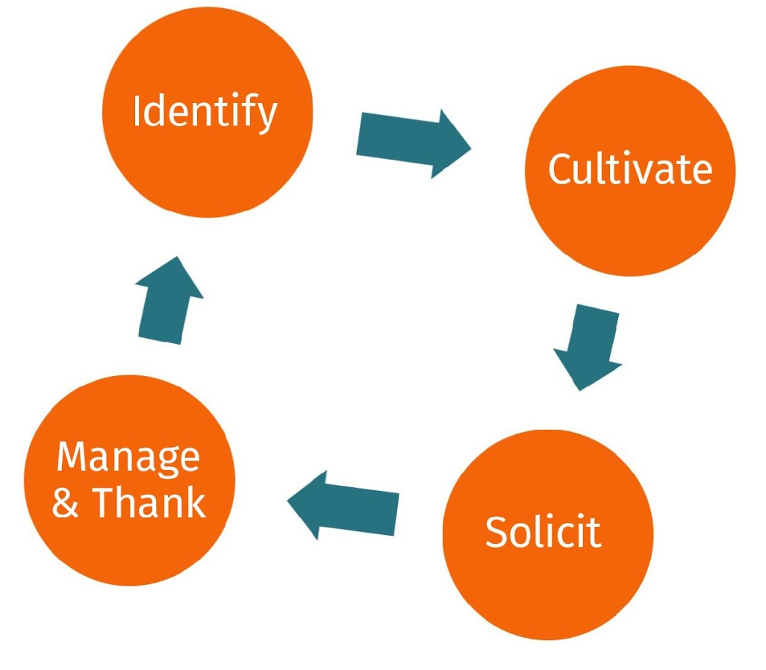
The 5 W’s of Major Giving
How?
Virtual Binder | Week 5 | Page 6

Slide 26










How to Make the Ask in 8 Steps
Prayer
Identification/Qualification
Development of a Strategy and Timetable
Cultivation
Solicitation and Negotiation
Acknowledgement and Follow-up
Administration
Renewal

Slide 27
The 8-Step Process: Step 1
Prayer
Holy God,
There was Eden, and then there was east of Eden;
Which is all to say—this world is not what you intended it to be.
You planted a garden and dreamed of Sabbath—and it was good.
It was so very good.
However, when we look around today, we know that we have lost our way.
So today we bring our hearts, minds, and money back to you in hopes that you will sow good. This is the work of restoration, for we want to be a restoration people.
Use these gifts for your hurting world.
Restore us to you, oh God.
Amen. *
Virtual Binder | Week 5 | Page 8

Slide 28
The 8-Step Process: Step 2
Identifying & Qualifying Prospects
How do you draft your list of potential major gift prospects?
Careful thought
Research
Previous giving records
Virtual Binder | Week 5 | Page 8

Slide 29

The 8-Step Process: Step 2
Your Turn:
The Constituency Model
Identifying your potential major donors
Virtual Binder | Week 5 | Page 9

Slide 30

The 8-Step Process: Steps 1 & 2
Your Turn:
The Constituency Model
Identifying your potential major donors
Virtual Binder | Week 5 | Page 10

Slide 31

8 Step Process: Step 3
Develop a Strategy and Timetable
1. Articulate the “Why”
  Mission and vision of congregation/diocese
  Connect the need to your Why, the mission, and vision
  The 4 Questions:
  - What is the project?
  - How much does it cost?
  - Who decided?
  - What do you need from me?
Virtual Binder | Week 5 | Page 11

Slide 32
8 Step Process: Step 3
Develop a Strategy and Timetable
2. Create the congregation’s Wish List
  Project
  Cost
  Timeframe
3. Plan your contacts
Virtual Binder | Week 5 | Page 11

Slide 33

8 Step Process: Steps 4-6
Cultivation
+ Solicitation and Negotiation
+ Acknowledgement and Follow-up
“Shepherding Process”
6 Cultivation Contacts
1 Ask
1 Follow-up
Virtual Binder | Week 5 | Page 12

Slide 34
8 Step Process: Step 5
Solicitation and Negotiation
Designing the Ask:
Where will the ask occur?
Who will do the ask?
Virtual Binder | Week 5 | Page 13

Slide 35
8 Step Process: Steps 6 & 7
Acknowledgement and Follow-up + Administration
How will you thank the donor?
Ideas:
Phone calls
Hand-written notes
Email or mail newsletters
Videos and photographs
Appreciation events
Annual reports
Virtual Binder | Week 5 | Page 15

Slide 36
8 Step Process: Step 8
Renewal
Beginning again from the beginning…
When should you ask a donor to give again?
Hint: It depends!
Virtual Binder | Week 5 | Page 16

Slide 37

A baby boomer couple who has been at the church for 25 years is a major giver in the community; specifically, to organizations like the YMCA, the Boys & Girls Club, and the local community choir. They give an average gift of about $2,500 and haven’t increased their gift in 10 years. You are in the middle of a capital campaign. This couple has not participated in the feasibility study. You would like to ask them to contribute to this campaign that would fund multiple projects in the parish. What do you do and how do you ask?
This capital campaign includes:
refurbishing the bell tower,
bringing the kitchen up to code to improve an existing feeding ministry and enhance hospitality,
Endowing a position for children, youth, & family.
Preparation:
How do you go about asking?
Role Play:
One of you is the asker, the other is the donor
And…Action!
Scenario: “Make the Ask” Activity
Virtual Binder | Week 5 | Page 17

Slide 38
Make the Ask
“Make the Ask” Activity Reflection: Self Assess
How did it go?
What was challenging about being the “ASKER”?
What was challenging about being the “DONOR”?
What was the most fun or satisfying part of the process?
Virtual Binder | Week 5 | Page 17

Slide 39
Make the Ask
A Few Reminders
Spirituality of Fundraising
  For the Donor: Making a Major Gift offers donors an opportunity to draw deeper into the faith community and what they see as their part in building the Kingdom; their vision of being an "instrument of God's peace.”
  For the Asker: Asking for a Major Gift allows the “asker” to use his/her gifts and passions to grow God’s work in this world.
Generative Mentality and Attitude of Gratitude
  Being positive, hopeful, faithful, and grateful will always bring more success than attitudes that are negative, fearful, unfaithful, and ungrateful. See Christ in each other!
Virtual Binder | Week 5 | Page 18

Slide 40

Team Time
Team Exercise:
Fill out your constituency model (page 9 of Virtual Binder)
Role Play by teams of 2 (page 14 of Virtual Binder)
Create a list of major gifts/dream list
Create a list of individuals with connections to passions and your congregation’s needs
Virtual Binder | Week 5 | Page 19

Slide 41

Week 6 - Project Resource
Prayers of the People

Slide 42
facebook.com/groups/projectresource

